Slide 1
B.K.
Pathways to Improv:
Try the Jazz Combo
with Your Big Band!
2024 FBA Summer Jazz Institute
Presented by:
Bobby Keating, Gulliver Preparatory School
Tim Ostrow, L.A. Ainger Middle School
Rhythm Section Elaboration by Shawn Marren

Slide 2
T.O.

Slide 3
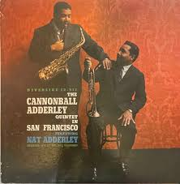
STEP 1: Listen
T.O.
Listen to recordings to understand style. Jazz is an aural art.
Work Song
Nat Adderley
Them Dirty Blues Album
Backing Track Examples
Find Other Ideas for Development

Slide 4
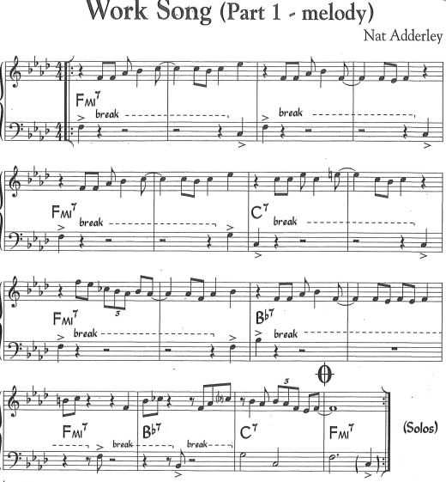
STEP 2: Learn the “Head”
T.O.
In the Real Easy Book, this is called “Melody 1”
Piano, Guitar and Bass should also learn this!
Drummers can play vibes using the C Book.
Get the entire band to play the Head
If you have trouble with this, try “Trading Twos”
In the last four you will need to “Trade Fours”
Don’t move on until they get it.

Slide 5
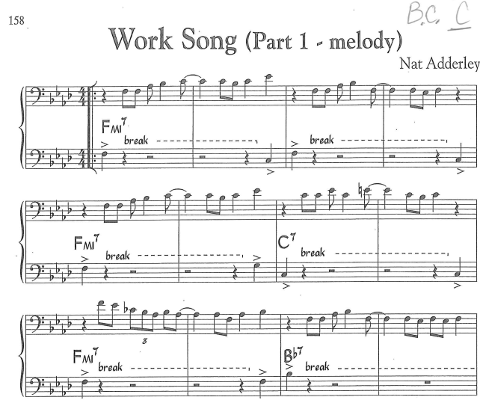
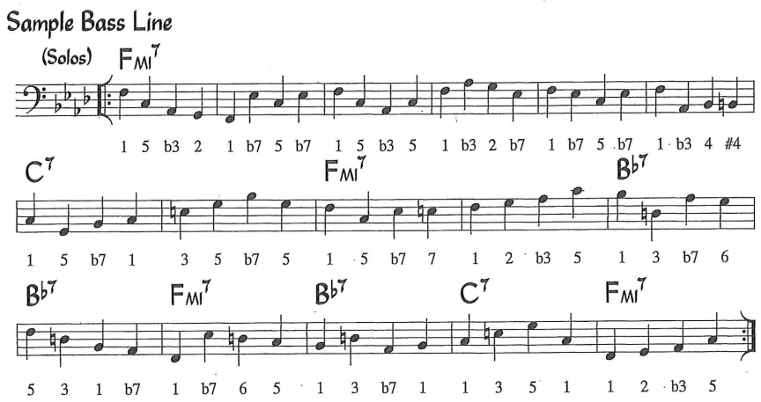
STEP3: Prep the Rhythm Section Bass
S.M.
Bass
Play the bass part as written on the bass clef (“Hits” on Beat 1 and 4).
The Winds can do this too (Part 3).
Outline each chord by playing the root and 5th on beats 1 and 3.
Learn the Sample Walking Bass Line.
Try adding eighths on a particular beat
Learn 3 Basic Patterns:
1-3-5-b5, 1-2-b3-3, 1-b7-6-5

Slide 6
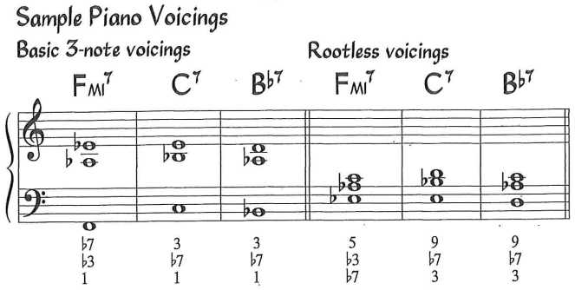
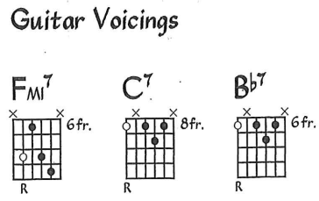
STEP 3: Prep the Rhythm Section Harmonics
S.M.
Piano and Guitar
Play whole notes and eventually syncopated comping patterns with the same voicings so they get comfortable with the changes and transitions.
The “Charleston Pattern” is a MUST.
When students are comfortable comping, have them play the chords in other voicings.
“3-7-Pretty”
“The Charleston”

Slide 7
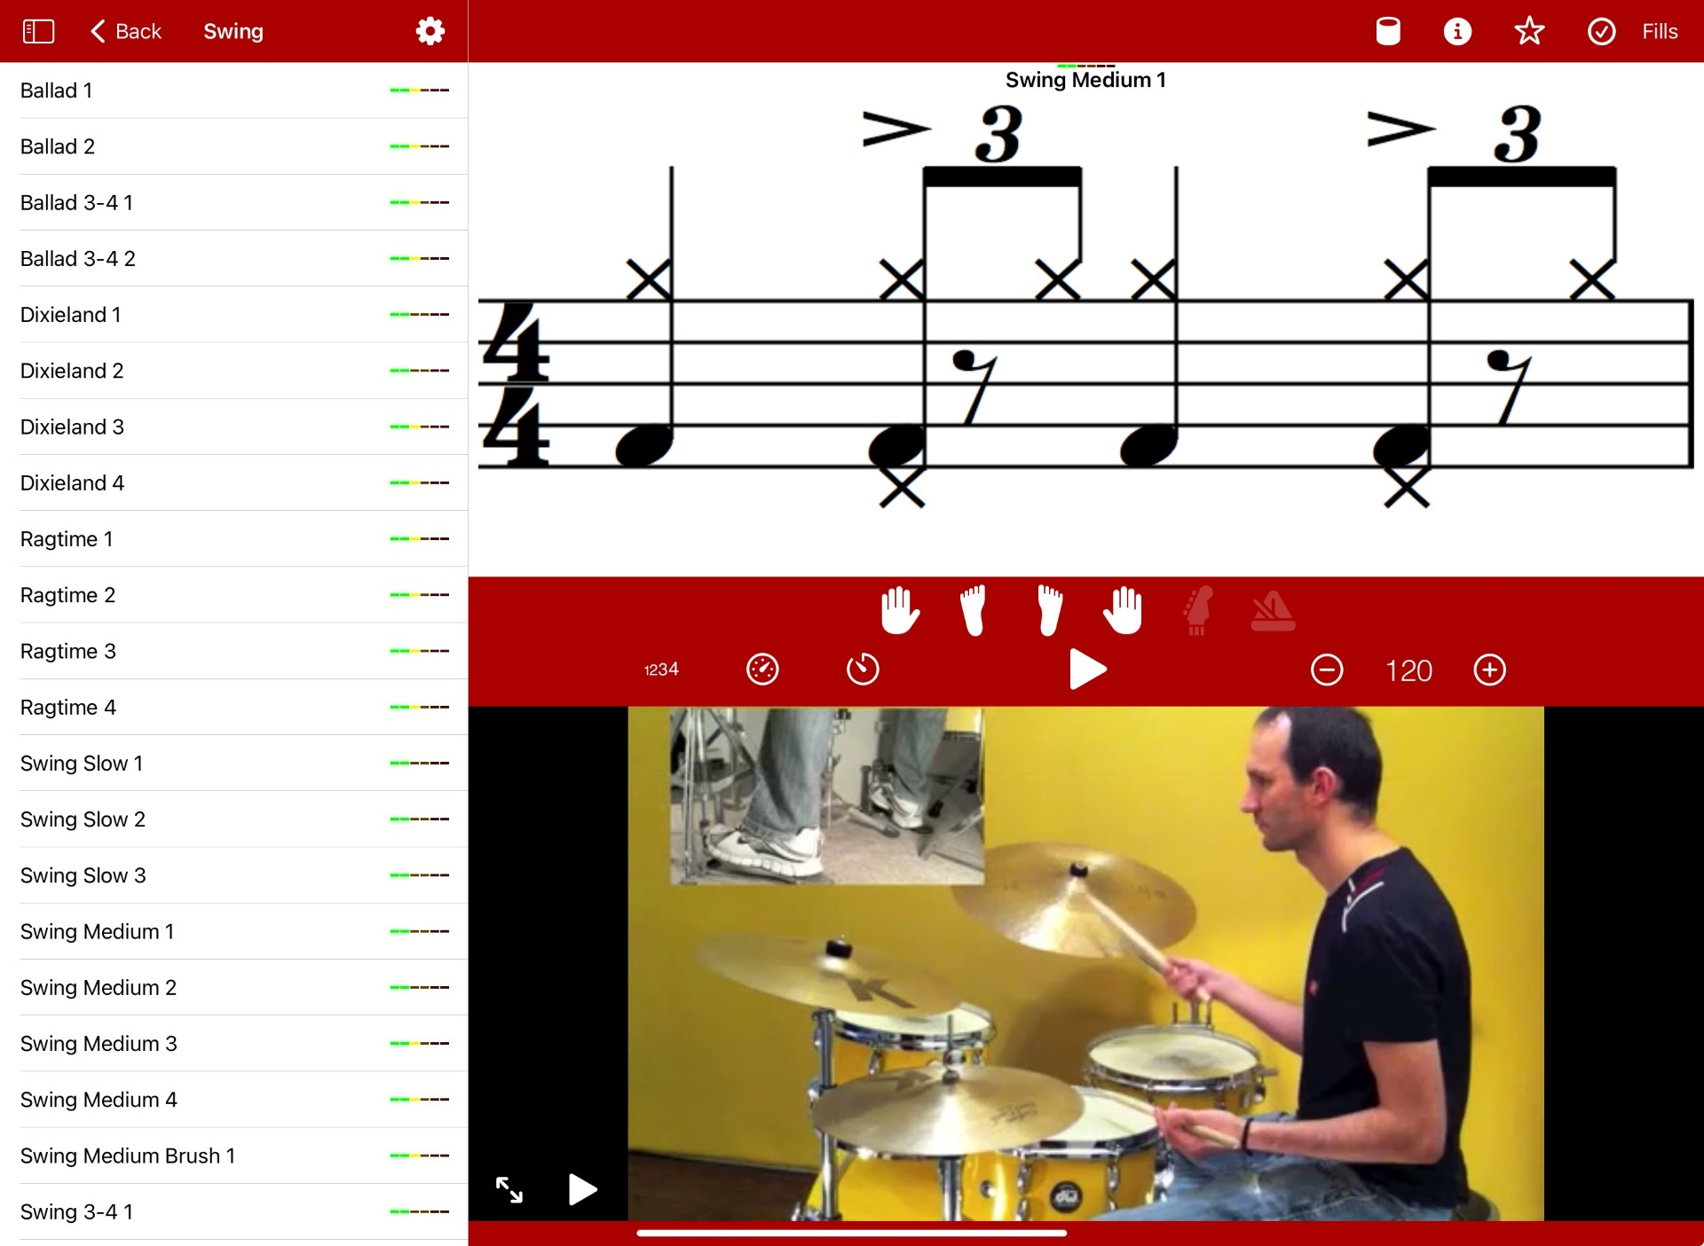
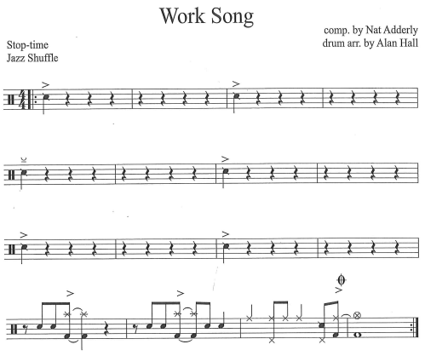
STEP 3: Prep the Rhythm Section Drums
S.M.
Drums
Learn a swing groove. Check out the “Drum School” App for ideas here.
Play the melody on just the SD.
Add simple hits and fills on the snare/tom/kick/crash.
At the end of every phrase (usually 4 bars).

Slide 8
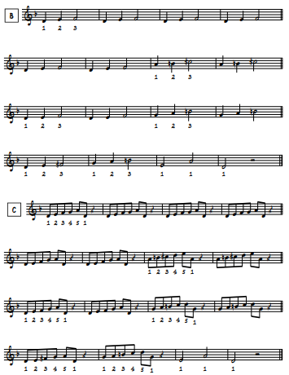
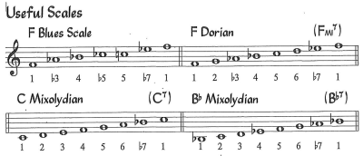
STEP 4: Teach the “Changes” Play Patterns
T.O.
Know which modes to use for each chord.
F Mi 7 = F Dorian
C 7 = C Mixolydian
Bb7 = Bb Mixolydian
Play modal patterns over the form emphasizing chord tones and recognizing passing tones.
If they struggle, this can be done by trading twos and fours on a vamp.

Slide 9
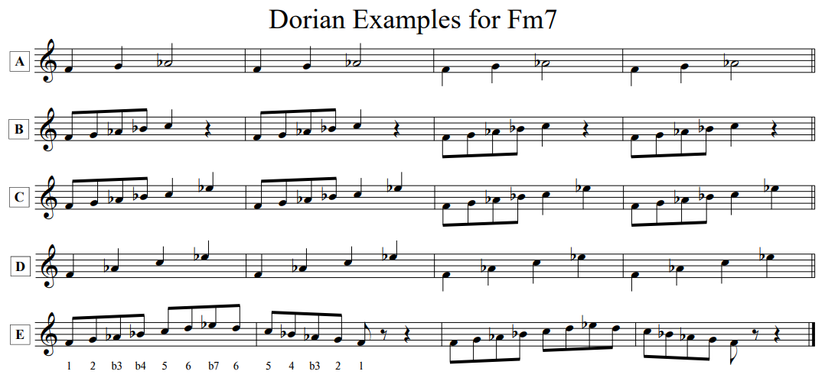
STEP 4: Teach the Changes Other Examples of Playing Patterns
T.O.
A=123
B =12345
C =123457
D = 1357
E =1234567

Slide 10
STEP 4: Teach the Changes Call and Response
T.O.
Play one or two bar “licks” and have them play them back in a “call and response”.
You might repeat this if they aren’t getting it, make it easier, or develop an idea depending on how they respond.
Let them be you where THEY play “licks” in call and response with the band.
Eventually, they should develop the confidence to start improvising over the changes.
1-b7-1
1-2-3-4-5-8
3-4-3-4-5-3-4-5

Slide 11
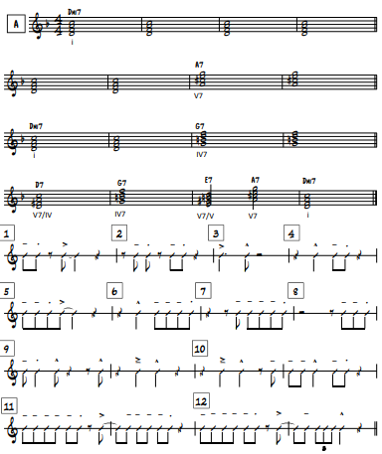
STEP 4: Teach the Changes Listen and Follow the Form
T.O.
Listen
Have students call out the chords as the rhythm section performs.
The “turn-around” (last four bars in this case) should be obvious.
Follow the Form
Make your own “backgrounds” using rhythm examples while playing chord tones.
Each player should find the smoothest voice-leading for their selection of notes.
For the turn-around, they can play it as written (two half notes and a whole note).

Slide 12
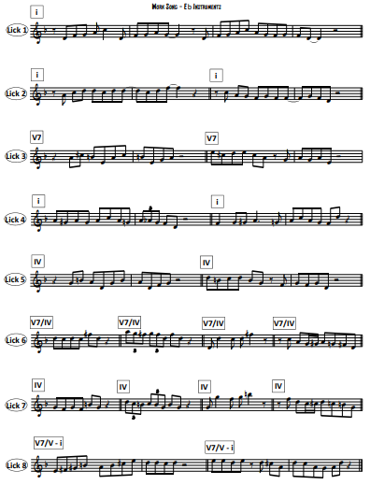
STEP 4: Teach the Changes Write Your Own “Licks”
T.O.
Rhythms
For each new chord, enter a phrase on beats 1, & of 1, or beat 2. See Examples 1-12 on the Handout.
If the chord is stretched for four bars, make your rhythm last 4 bars.
Leave space at the end of each phrase.
Notes
Write phrases that fit the chord/modes.
It is recommended that beats 1 and 3 should land on a chord tone.
Articulations
Personally, I like to leave this blank and then model the style.
You will slur a lot and typically end on a “stop-tongue” or “doo-it”.
Form
Whatever you write, make sure they know when to apply each lick!

Slide 13
STEP 5: Play the Entire Chart! Improvise in the Middle
T.O.
The Real Easy Book has other resources in it to allow your students to play a “full” chart.
Backgrounds, shout sections, harmonized heads, codas.
Agree on a form and let them play!
Head X2 (Melody 1, Hits in Rhythm Section the 1st Time)
Solos! (Each Soloist gets 2 Choruses to allow time to develop)
During Solos – make your own background or play the suggested one in the book
Head X2
This time, use the “Melody Part 2 and Melody Part 3” for Harmony!
Coda
Communicate with each other, but especially the drummer (Wind Noodle, Drum Solo, Bass Solo)

Slide 14
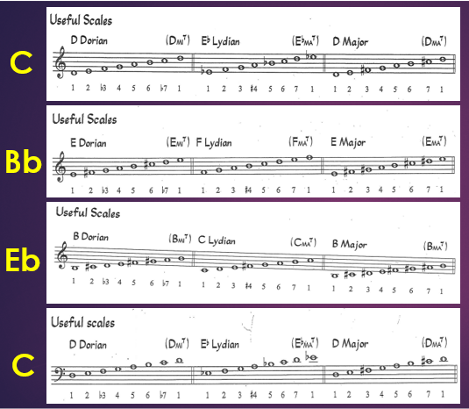
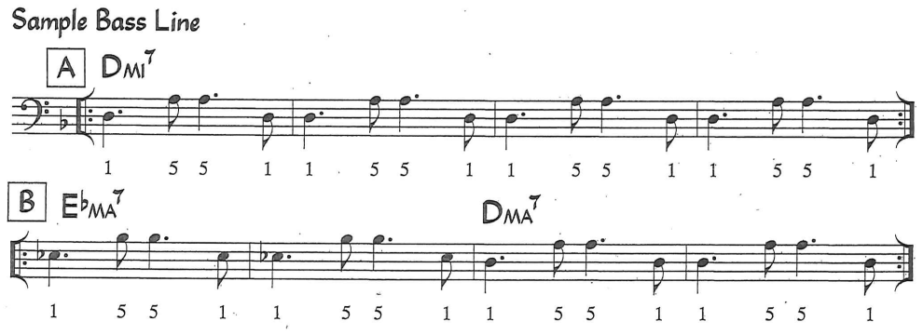
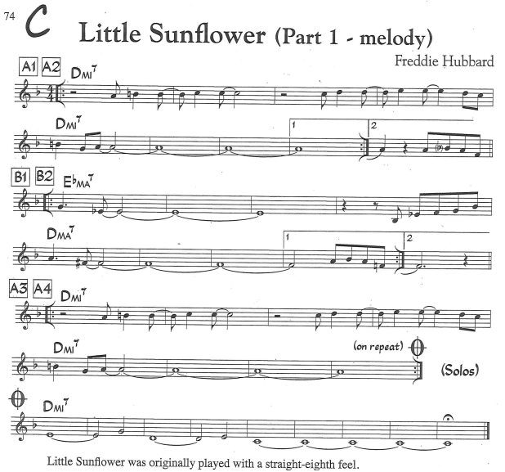
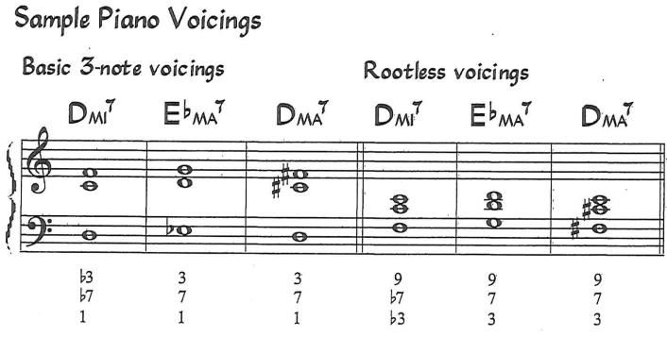
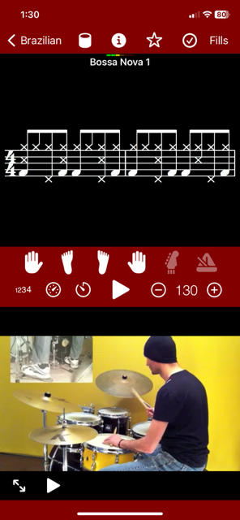
Apply Elsewhere Same Concepts, Different Tune!
B.K.
Little Sunflower
Step 1: Listen!
By Freddie Hubbard (trumpet)
Step 2: Learn the Head
32 Bar Form (AABA)
Step 3: Prep the Rhythm Section
Latin Style
Step 4: Teach the Changes
3 Chords/Modes!
Step 5: Play the Chart!
Focus on the Form and Improvise!
|: Dorian X8 :|
Lydian X4
Major X4
|:
:|
|: Dorian X8 :|

Slide 15
B.K.
THANK YOU FOR ATTENDING!
Questions?
Ideas?
2024 FBA Summer Jazz Institute
Pathways to Improv
Presented by:
Bobby Keating, Gulliver Preparatory School
Tim Ostrow, L.A. Ainger Middle School
Rhythm Section Elaboration by Shawn Marren

