Slide 1
Jazz Drummers Toolbox!
Teaching You (The Director!) Some Licks To Help Your Drummer “Jazz” Up Your Band!
Florida Bandmasters Association Summer Jazz Institute
Thursday, July 18th, 2024
Jeremy Langford

Slide 2
It’s All About The Feel!

Slide 3
Let’s Start Drummin’!
RH
RH
RH
RH
RH = Right Hand
LH = Left Hand
RF = Right Foot
LF = Left Foot

Slide 4
Let’s Start Drummin’!
RH
RH
RH
RH
RH = Right Hand
LH = Left Hand
RF = Right Foot
LF = Left Foot
RF
RF
RF
RF

Slide 5
Let’s Start Drummin’!
RH
RH
RH
RH
RH = Right Hand
LH = Left Hand
RF = Right Foot
LF = Left Foot
RF
RF
RF
RF
LF
LF

Slide 6
Let’s Start Drummin’!
RH
RH
RH
RH
RH = Right Hand
LH = Left Hand
RF = Right Foot
LF = Left Foot
LH
LH
RF
RF
RF
RF
LF
LF

Slide 7
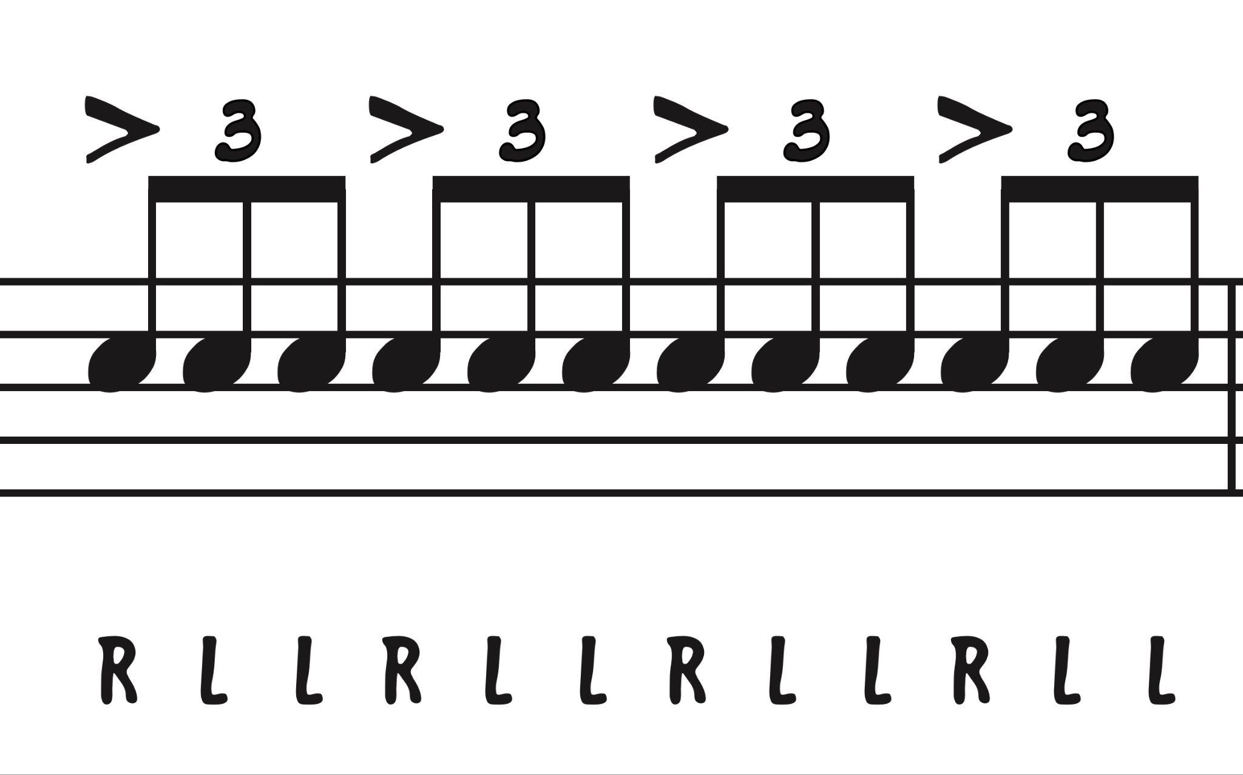
Let’s Swing!
Part 1
“Feeling”
The Downbeat

Slide 8
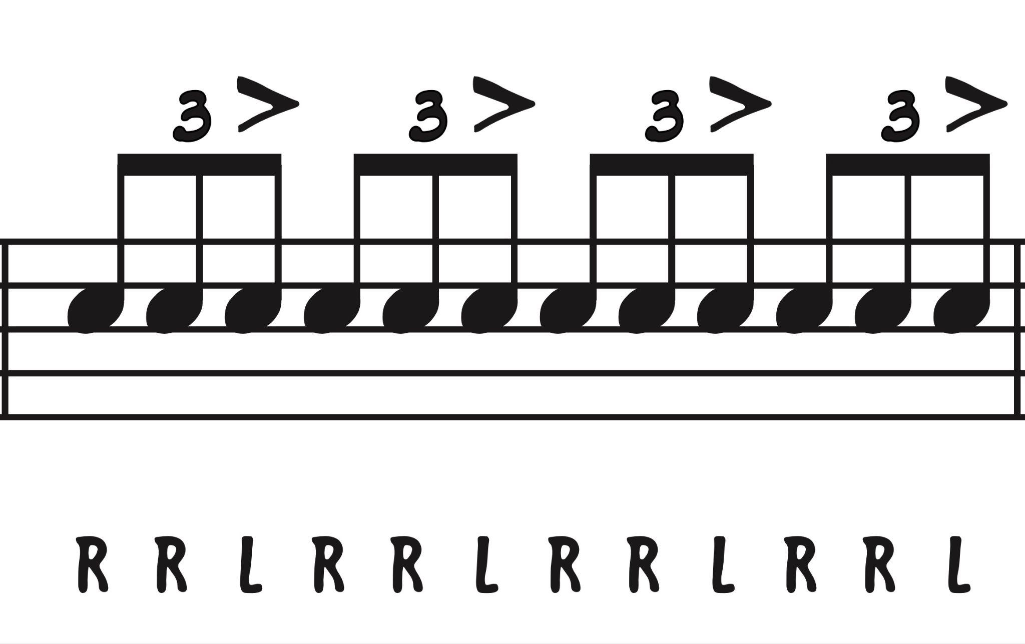
Let’s Swing!
Part 2
“Feeling”
The Upbeat

Slide 9
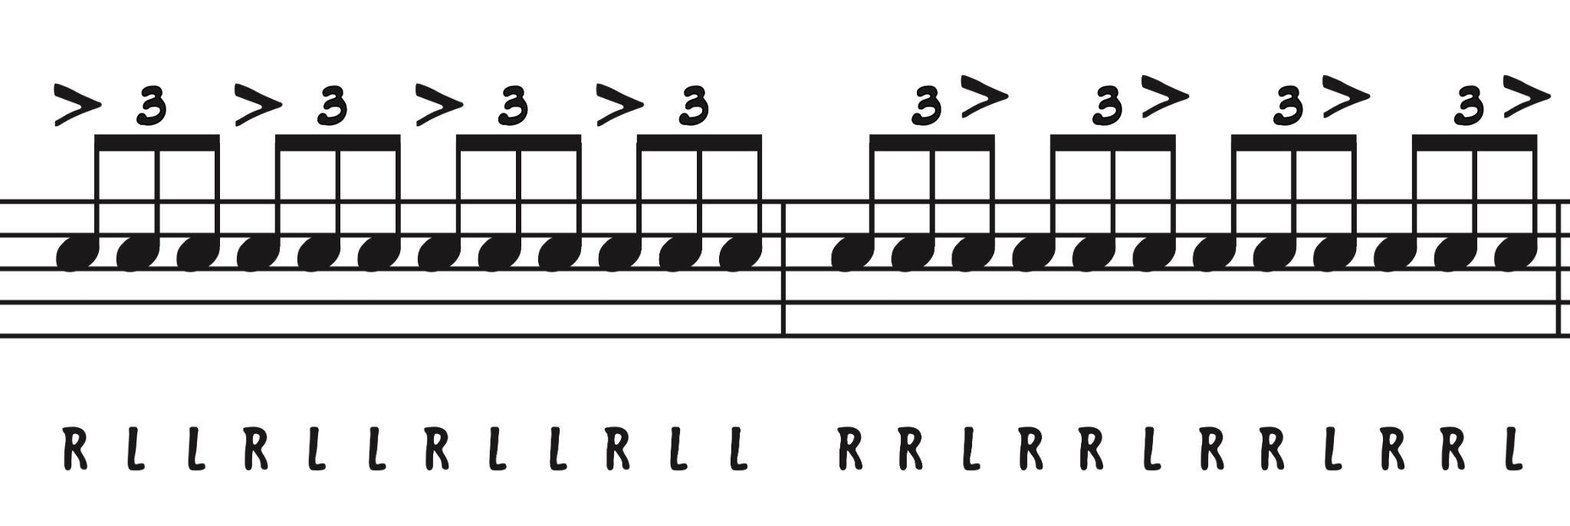
Putting Them Together!
Loop It!

Slide 10
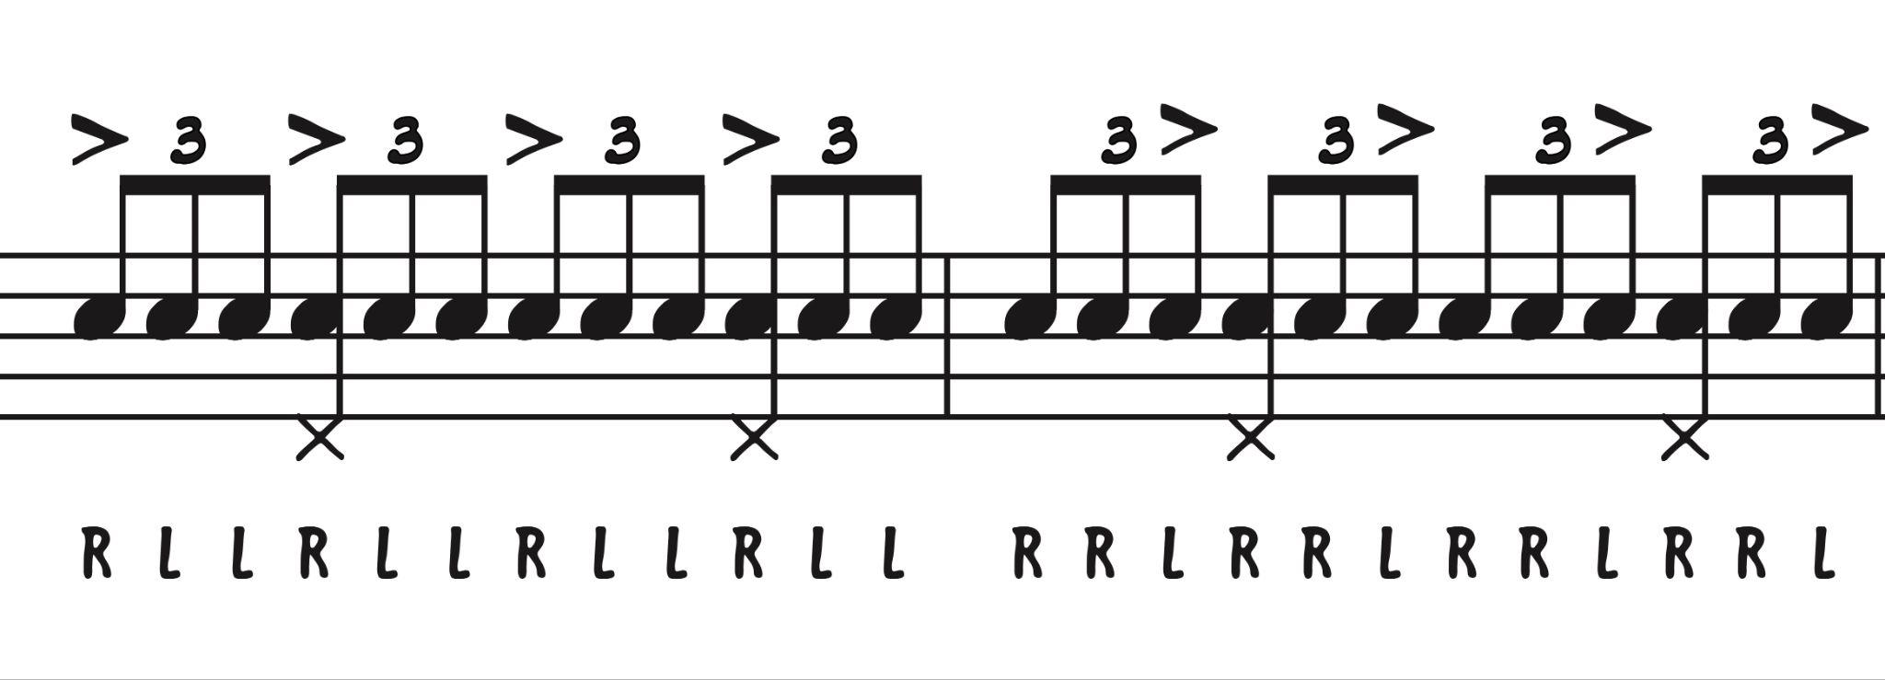
Addin’ A Little More!
+LF (HH)

Slide 11
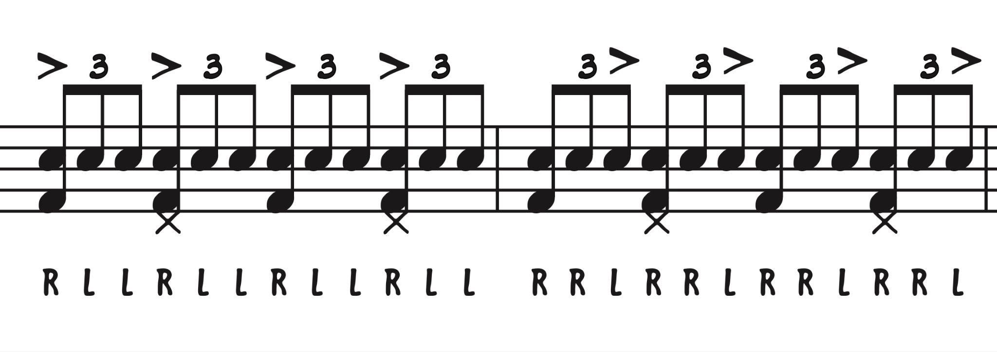
Don’t Forget The Kick!
+RF (Kick)
“4 On
The Floor”
(Training
Wheels!)

Slide 12
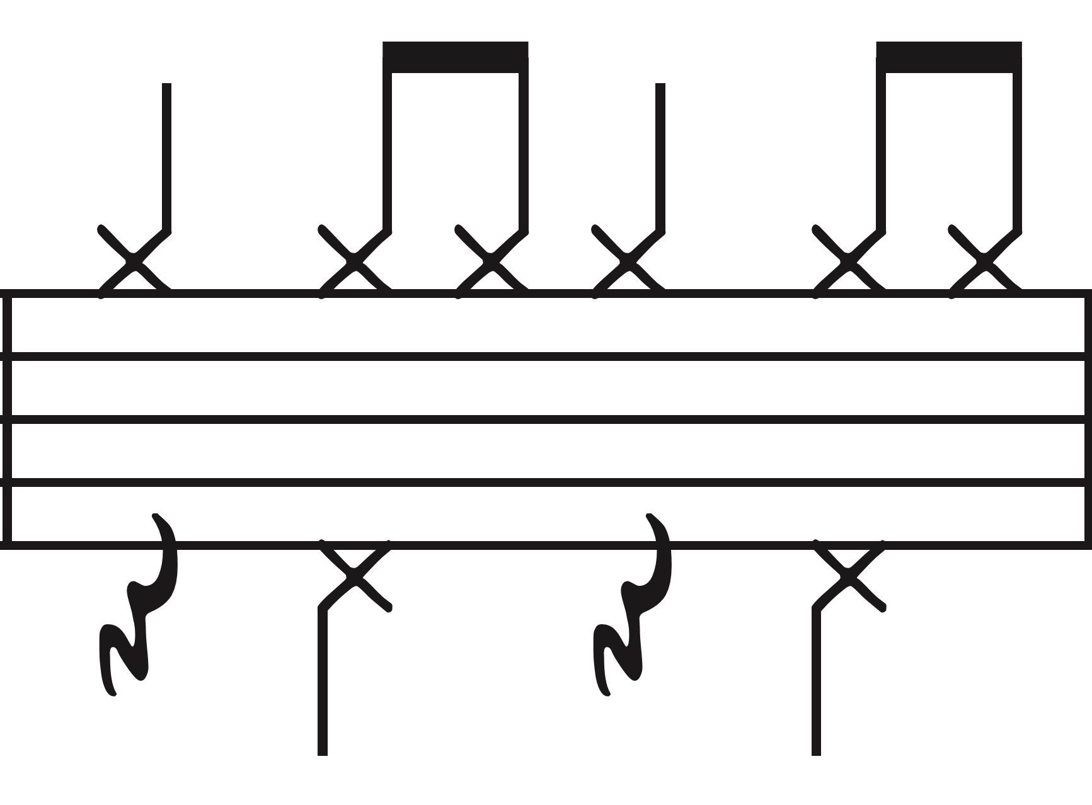
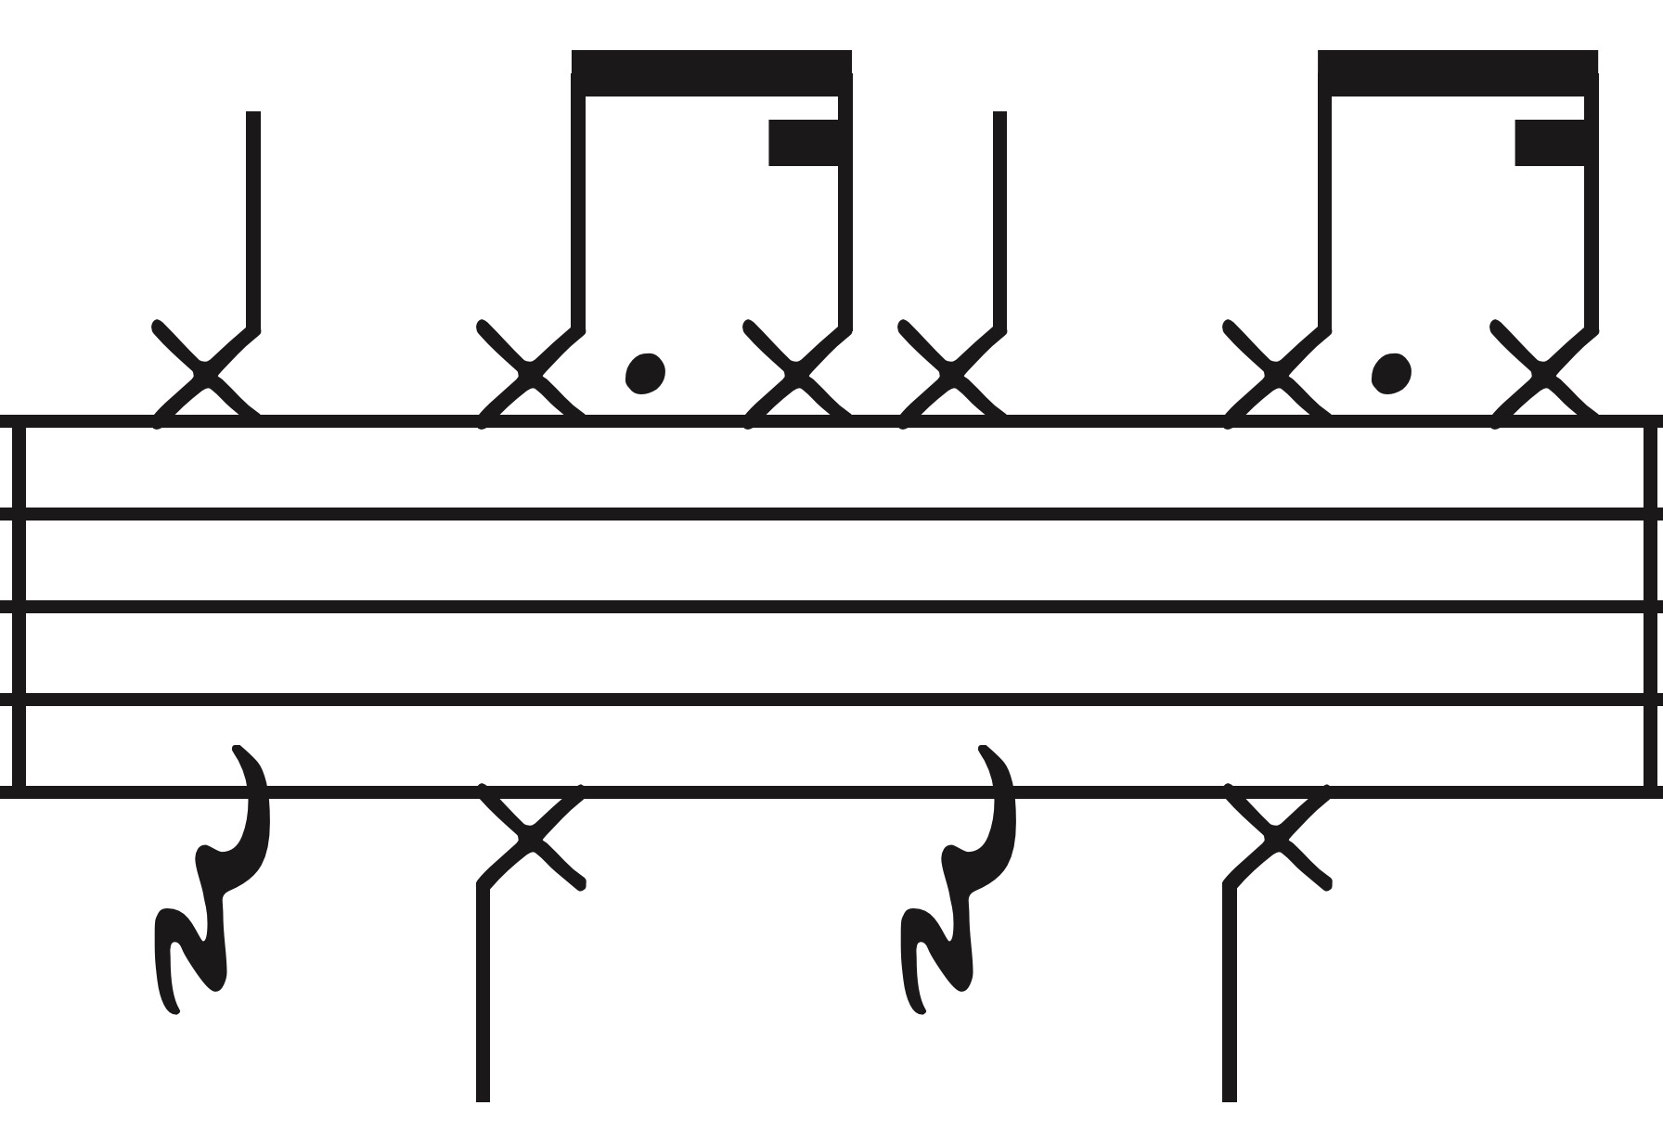
So How Do We Make These “Feel” Right?

Slide 13
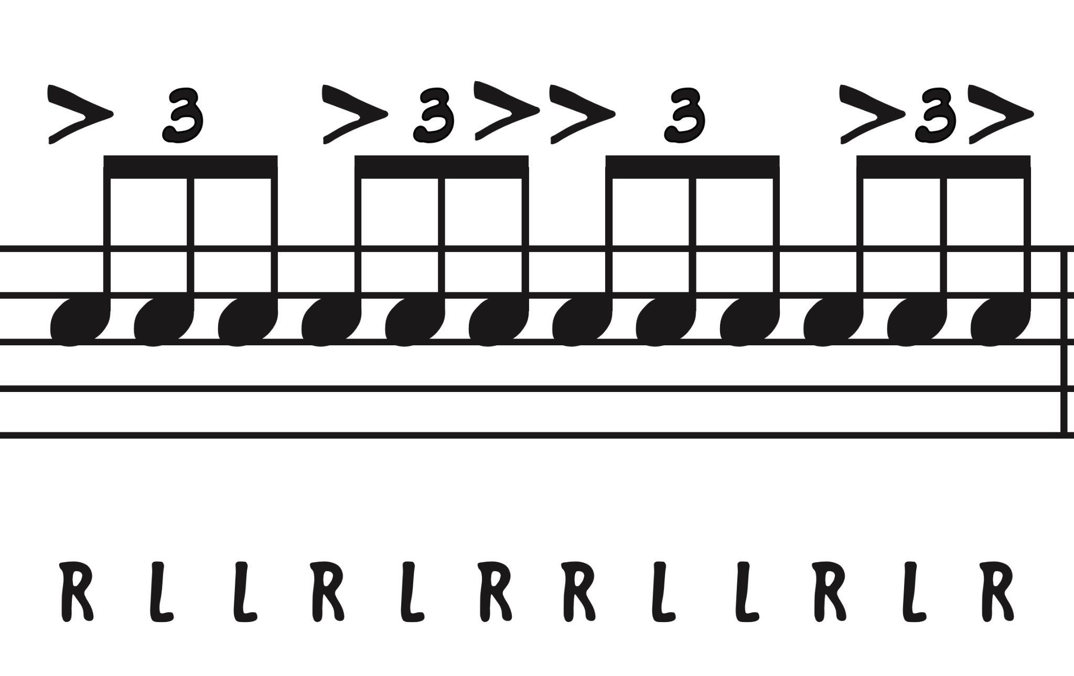
This Is It! THE SLIDE OF ALL SLIDES!
All Roads In Swing Lead To This!
Developing Feel!
“Triplet Overlay”

Slide 14
Let’s Play These Figures With Some Slow Blues!
Let’s Get On The Drum Sets & Give It A Whirl!

Slide 15
So How Do We Get Them There?
Slow & Steady!
Do you have a simple, daily bluesy-type riff that you play? If not, find something similar to Mike Sweeney’s “Instant Warm Ups” and use #1! Perfect for perfecting the “FEEL” of swing! And many other wonderful things!
Use the DOWNBEAT and UPBEAT Triplet Grooves to build the vocabulary in their hands. Let them experiment with these rhythms and stickings inside your swing tunes to find the right application.

Slide 16
Making The “Swing” More Genuine…
Ways To Swing It Up…
1. Kack Kack (As often as feels appropriate) >
2. Sock Hi Hat/Stick Click (Lighter textures) >
3. Chopping Wood (Helps create drive) >
4. Avoiding Training Wheels (4 On The Floor) >
5. Don’t Be Afraid Of Starting With Triplets! >
Thoughts On Achievement…
… How many ways can we “kack kack”?
… When should I use this combo?
… How many colors of “chop” are there?
… Why? Seriously? You have me do this earlier! :)
… Nothing like a good lead in to build up the band!

Slide 17
Anything Else I Can Take Back To Them?
Phrase Shifts Are A Fun Way To Sell The Change!
Change elements at new phrase point…
Ex: Ride/SD, Ride/Chop, HH/SD, HH/Chop
Can be the EXACT SAME RHYTHM, but you now have four “variations”. This gives the listener the variety they need to enjoy the new phrase. (Sameness can be detrimental!)
Set up with a simple FILL to transition to new combo. One note can say enough…. BEAT 4!

Slide 18
So How Do They Kick The Band?
Glad You Asked!
Proactive vs. Reactive Drumming…
The “Art” Of The Set Up (Kack Kack, etc.)...
Fills…
The Band “Feeds” Off Of The Drummer’s Energy… aka STYLE! It Is Contagious!
Usually getting the drummer to feel this once will hook them and create desire to learn more. There is a unique connection and responsibility in knowing you are the driver!

Slide 19
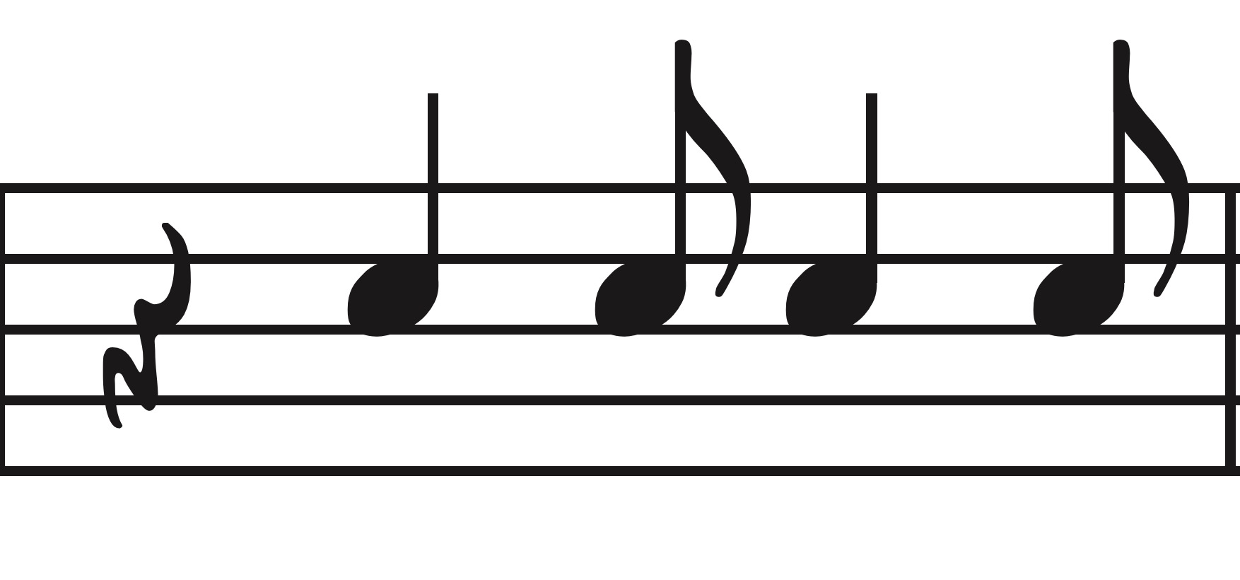
Example Of “Kicking” The Band…
Example Kick Rhythm (From “Fat Cat” by Doug Beach)

Slide 20
From The Score:
Fat Cat by Doug Beach

Slide 21
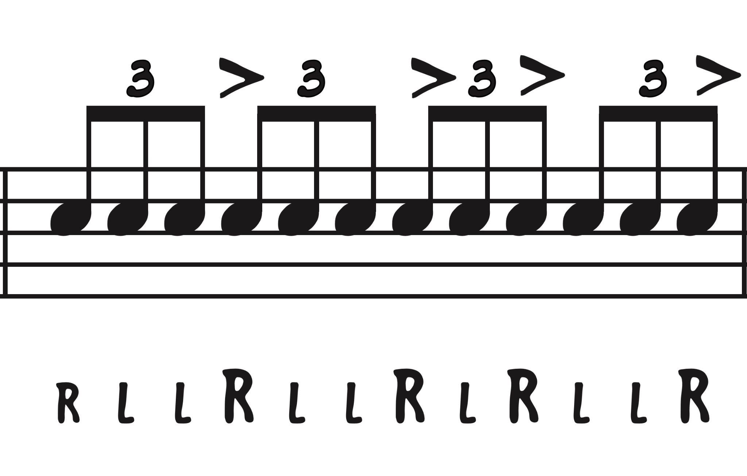
Building The “Feel” Through Triplet Overlays
RH becomes ACCENTS, LH fills time.

Slide 22
Kick Examples & Combos
Be sure to ALWAYS add a KICK with the CRASH!

Slide 23
More Tidbits For Greater Authenticity!
What Else Should I Consider To Help Build Their “Feel” & Vocabulary?
Drum Set “Set Up” & A Good Throne Matters! (Creates Balance!)
Every CRASH Gets A KICK! (Reference the Fat Cat lick!)
The RIDE CYMBAL carries a ton of the DYNAMIC weight of the band! Be careful and do not let the overtones carry you & the band away!
A FILL, no matter how subtle, should always precede a PHRASE SHIFT!
Articulation matters! Find a way to get the drummer to match sounds! (How do we prepare an accent in the wind band?) :)
When rehearsing the winds, have them give you TWO & FOUR on the Hi Hat for consistency of time! Make it AUTOMATIC!
When comfortable, LAY OFF “Ding-Da-Ding” on every beat! Give some space! Use it sparingly!
VAMPING is the BFF of DEVELOPMENT. Give meaningful, not woeful, reps, everyday to build feel and cohesion!
Got any local pro’s nearby that can come show a lick or two? Can be TRANSFORMATIVE!
Does your room allow for a perma-jazz (or rhythm section!) set up? This will lead to more practice if the kit is available - BUT - I get it! It can also be a magnet to not-so-good things! :) Just a thought!
Find an APP that slows things down for play back… I am using ANYTUNE today!
All State Jazz Audition is a WONDERFUL THING! Builds skill and chops!
Anything else you need? Questions? YOU CAN ALWAYS REACH OUT! ANYTIME!
Use as they apply and you can fit them into your rehearsal layout!

Slide 24
Now… TIME FOR YOU TO PLAY!!!
DON’T BE SHY! Come on up!
Watch me for cutoffs so we can try some licks together!
Try and lock in with the recording!

Slide 25
DO NOT HESITATE! AT ALL! HERE TO HELP!
Jeremy Langford Today’s PPT ->
(352) 267-3818 For Reference!
Best way is to send a quick video of your drummer and/or ensemble with the specific question or a pic of the lick.
I can sit at my kit and send a quick hit back to show both you and your kiddo as an example. Always happy to do that for you! Don’t wait until it is too late! Need time to absorb and experiment!
FBA Jazz Institute

